Slide 1
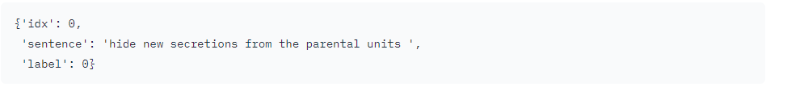
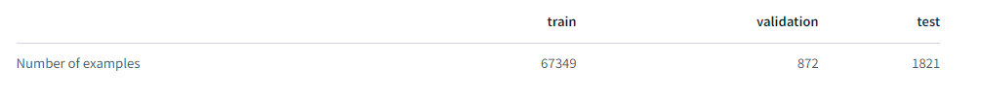
SST-2
Summary
The Stanford Sentiment Treebank is a corpus with fully labeled parse trees that allows for a complete analysis of the compositional effects of sentiment in language.
The corpus is based on the dataset introduced by Pang and Lee (2005) and consists of 11,855 single sentences extracted from movie reviews.
Data instances
Data Splits

Slide 2
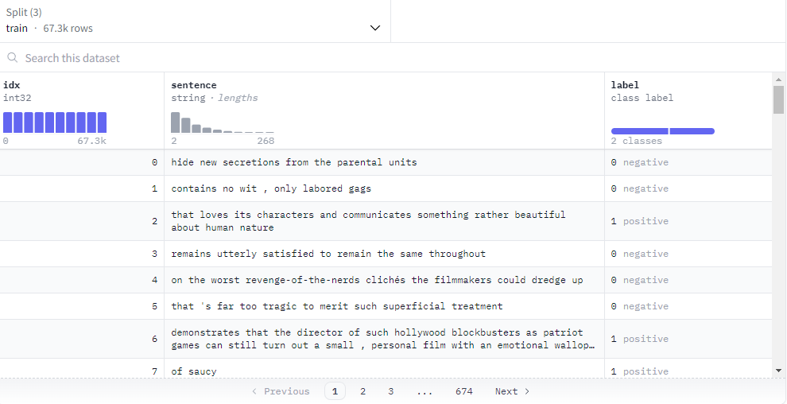
SST-2

Slide 3
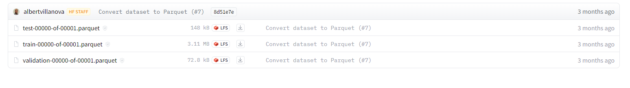
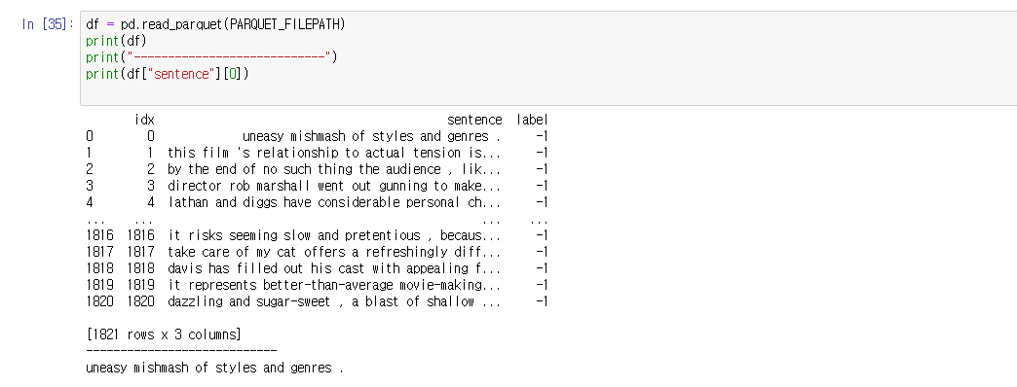
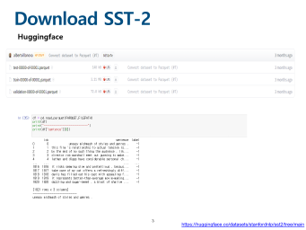
Download SST-2
Huggingface
https://huggingface.co/datasets/stanfordnlp/sst2/tree/main

Slide 4
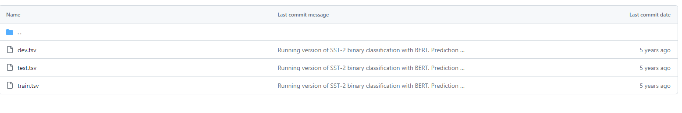
Download SST-2
Github
https://github.com/brunnurs/binary-classification-bert/tree/master/data/SST2

Slide 5
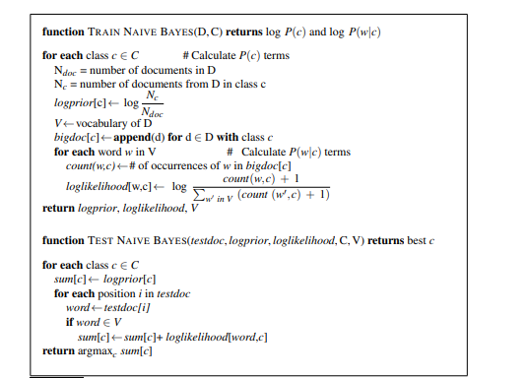
Naïve Bayes algorithm from scratch

